Slide 1
Dang nhap
Dang ki
Ten dang nhap
Mat khau
Dang nhap
Xoa

Slide 2
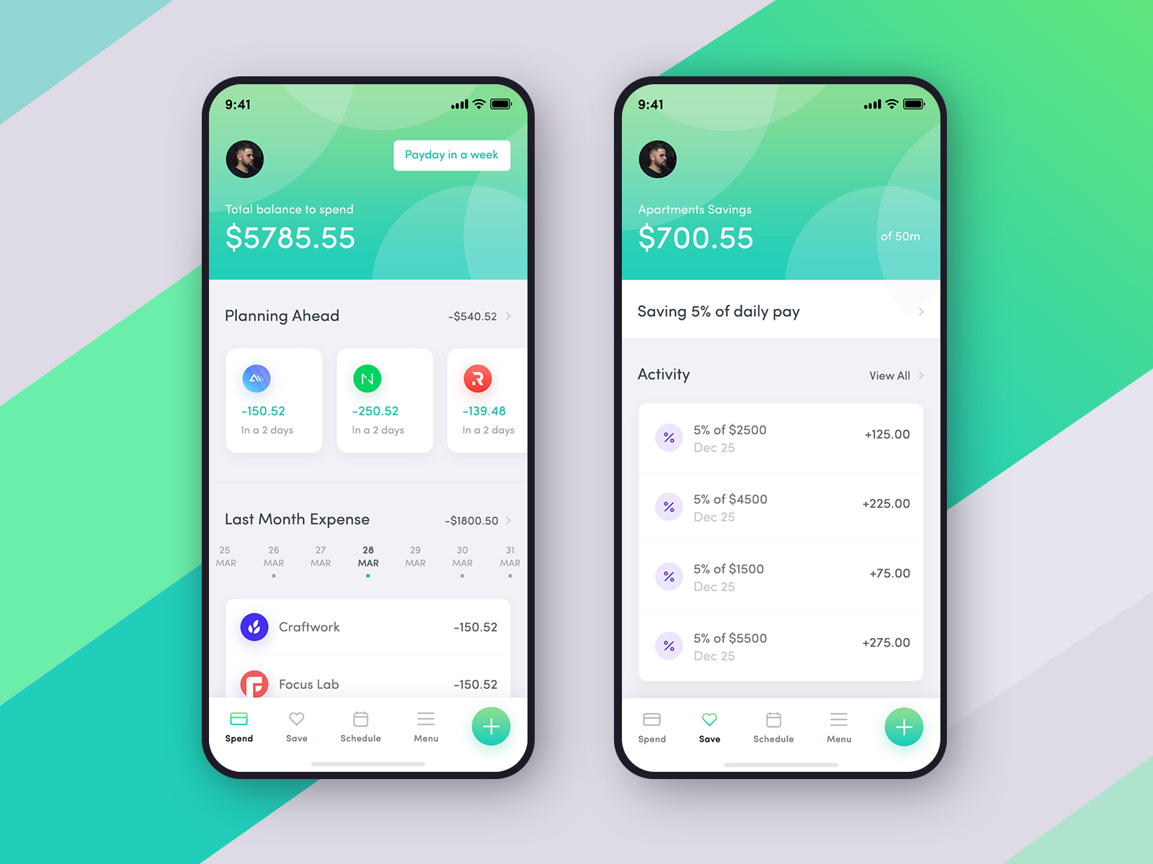
Tong quan
Nhap, sua so lieu
Phan tich
Loai chi phi
Loai thu nhap
Ten tai khoan
Tien nha
Tien an
Tien xe
Tien luong
Tien doc cho
Mat khau
Thay doi

Slide 3
Tong quan
Nhap, sua so lieu
Phan tich
Loai chi phi
Loai thu nhap
Ten tai khoan
Tien nha
Tien an
Tien xe
Tien luong
Tien doc cho
Mat khau
Thay doi

Slide 4
Tong quan
Nhap, sua so lieu
Phan tich
Loai chi phi
Loai thu nhap
Ten tai khoan
Tien nha
Tien an
Tien xe
Tien luong
Tien doc cho
Mat khau
Thay doi

Slide 5
Tong quan
Nhap, sua so lieu
Phan tich
Loai so lieu
Nhap tay
Thu nhap
Chi phi
Loai thu nhap/chi phi
Nhap excel
Tien nha
Xuat excel
Tien dien
So tien
Ngay

Slide 6
Tong quan
Nhap, sua so lieu
Phan tich
Chon tap tin Excel
Nhap tay
Loai so lieu | Loai thu nhap/chi phi | So tien | Ngay
Thu nhap | Tien luong | 100 | 13/12/2020
Chi phi | Tien nha | 10 | 17/12/2020
Nhap excel
Xuat excel

Slide 7
Tong quan
Nhap, sua so lieu
Phan tich
Thu nhap
Chi phi
Tong quat

Slide 8
Tong quan
Nhap, sua so lieu
Phan tich
Thu nhap
Chi phi
Tong quat

Slide 9
Tong quan
Nhap, sua so lieu
Phan tich
Thu nhap
Chi phi
Tong quat

Slide 10
Tong quan
Nhap, sua so lieu
Phan tich
Thu nhap
Chi phi
Tong quat

